Slide 1
Wally
A Fine-Tuned Sentence
Transformer for Wavelength.
Reece Galgana
CS 489-1001: Final Project
Dr. Bryar Shareef
How to Play Wavelength
Draw a word pair.
Psychic gives a clue.
Guesser tries to deduce hidden range.
Guesser gets more points when closer to middle.

Slide 2
Wally
A Fine-Tuned Sentence
Transformer for Wavelength.
Reece Galgana
CS 489-1001: Final Project
Dr. Bryar Shareef
How to Play Wavelength
Draw a word pair.
Psychic gives a clue.
Guesser tries to deduce hidden range.
Guesser gets more points when closer to middle.
Data Augmentation
Originally used the WavelengthEval Dataset (100 rows).
Played and documented too many games (1500 rows).
30 word pairs. 50 clues per pair.
5 responses per clue.

Slide 3
How to Play Wavelength
Draw a word pair.
Psychic gives a clue.
Guesser tries to deduce hidden range.
Guesser gets more points when closer to middle.
Data Augmentation
Originally used the WavelengthEval Dataset (100 rows).
Played and documented too many games (1500 rows).
30 word pairs. 50 clues per pair.
5 responses per clue.
Model Architecture
Pretrained sentence embedder: Sentence Transformers’
all-mpnet-base-v2.
Unfroze the last four layers to implicitly learn axis projection.
Applied a regression output node, to calculate a [0, 100] guess.

Slide 4
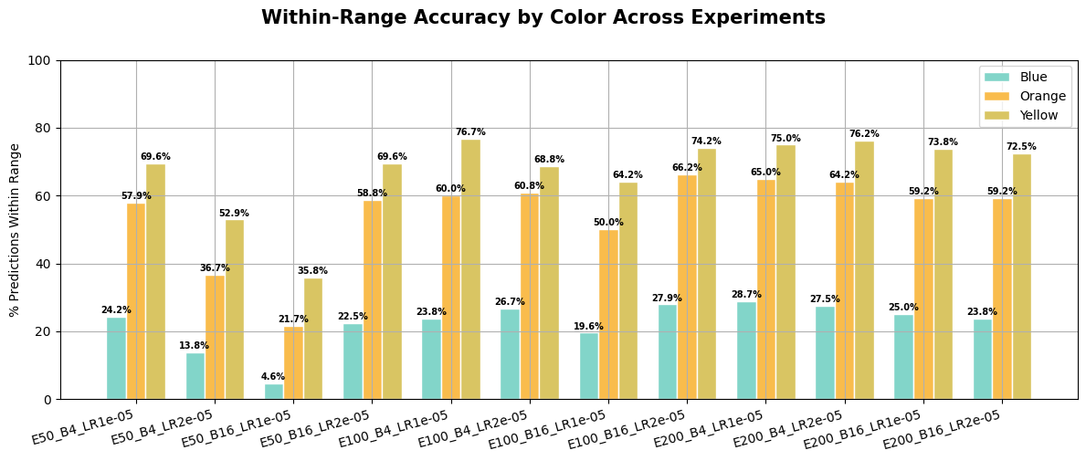
Data Augmentation
Originally used the WavelengthEval Dataset (100 rows).
Played and documented too many games (1500 rows).
30 word pairs. 50 clues per pair.
5 responses per clue.
Model Architecture
Pretrained sentence embedder: Sentence Transformers’
all-mpnet-base-v2.
Unfroze the last four layers to implicitly learn axis projection.
Applied a regression output node, to calculate a [0, 100] guess.
Experimentation
12 total experiments, tweaking epochs, batch size, and LR.

Slide 5
Model Architecture
Pretrained sentence embedder: Sentence Transformers’
all-mpnet-base-v2.
Unfroze the last four layers to implicitly learn axis projection.
Applied a regression output node, to calculate a [0, 100] guess.
Experimentation
12 total experiments, tweaking epochs, batch size, and LR.
Best Model
MAE: 13.31
Pearson (r): 0.805
Within-Blue Acc: 23.75%
Within-Orange Acc: 60.00%
Within-Yellow Acc: 76.67%

Slide 6
Experimentation
12 total experiments, tweaking epochs, batch size, and LR.
Best Model
MAE: 13.31
Pearson (r): 0.805
Within-Blue Acc: 23.75%
Within-Orange Acc: 60.00%
Within-Yellow Acc: 76.67%
See it Yourself:
http://127.0.0.1:5000

Slide 7
Best Model
MAE: 13.31
Pearson (r): 0.805
Within-Blue Acc: 23.75%
Within-Orange Acc: 60.00%
Within-Yellow Acc: 76.67%
See it Yourself:
http://127.0.0.1:5000

